Slide 1

All Hazards Application of RCM in BC
Ash Richardson
Band 3 Senior Data Scientist
BC Wildfire Service (FLNRO)
Digital Platforms and Data Division (CITZ)
Canadian Space Agency (CSA) Radarsat Constellation Mission (RCM) Users' Group Meeting (Nov 25th, 2021)

Slide 2
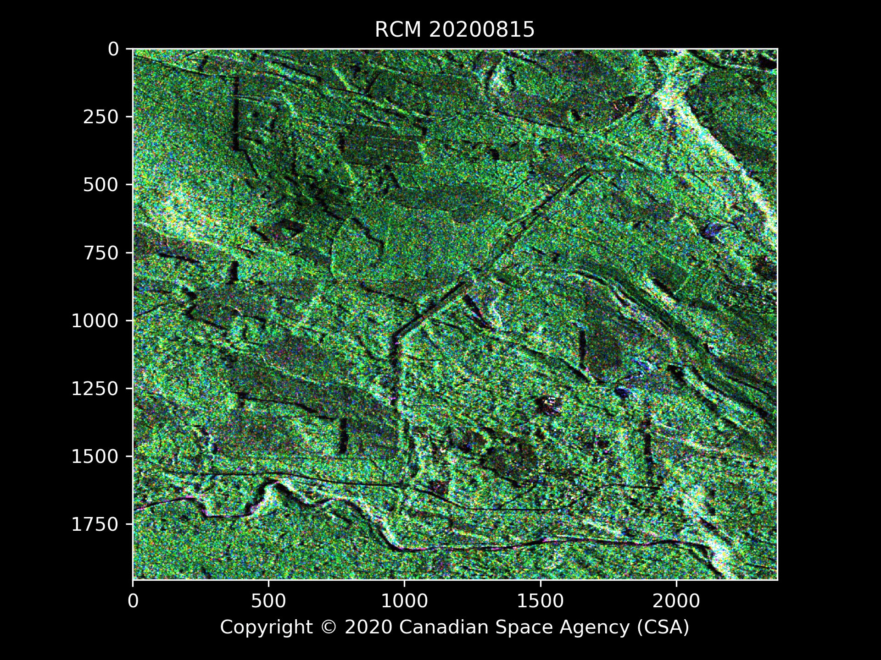
Roadmap
Context
Data Science approach
Partnerships and Capacity building
incl. GeoSci and RS
BCWS Predictive Services Unit
Mandate and collaborations
RCM CP-Polarimetry 5m
Sparks Lake mega-fire (2021)
Outlook
Collaboration!

Slide 3
Context
ECCC
DRDC
GOC
CCRS
CCMEO
Public Safety Canada
EMBC leads for emergency response (PECC):
All natural hazards
MoH leads for Public health hazards (HECC)
Wildfire mgmt branch is responsible for fires
…
Here to help build relationships with CSA and key partners
Thanks for the opportunity to work with you
Feel free to task me Ashlin.Richardson@gov.bc.ca
CF
NRCAN
CFS
EMBC
GeoBC
CITZ
BC Forest Inventory
BC Wildfire Service

Slide 4
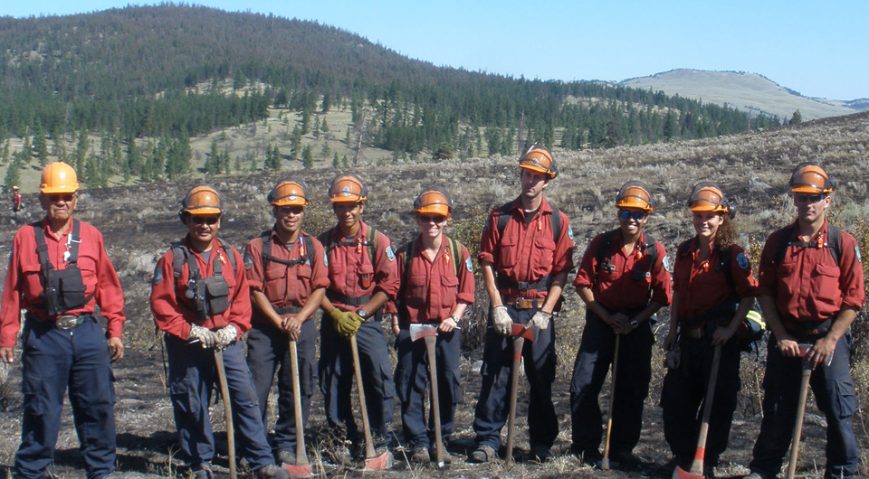
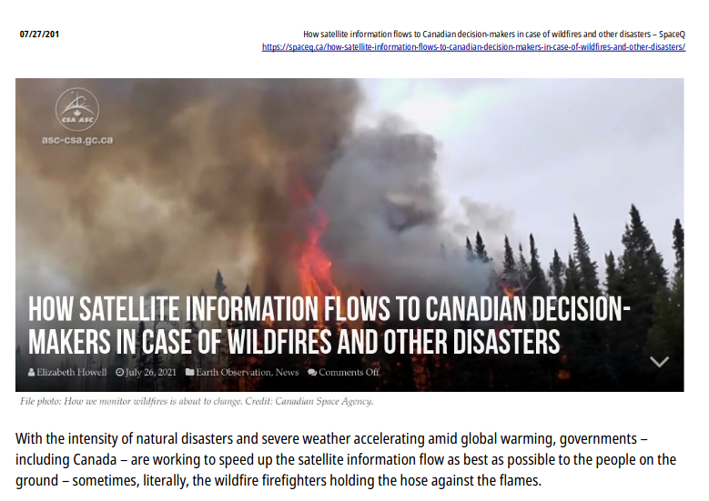
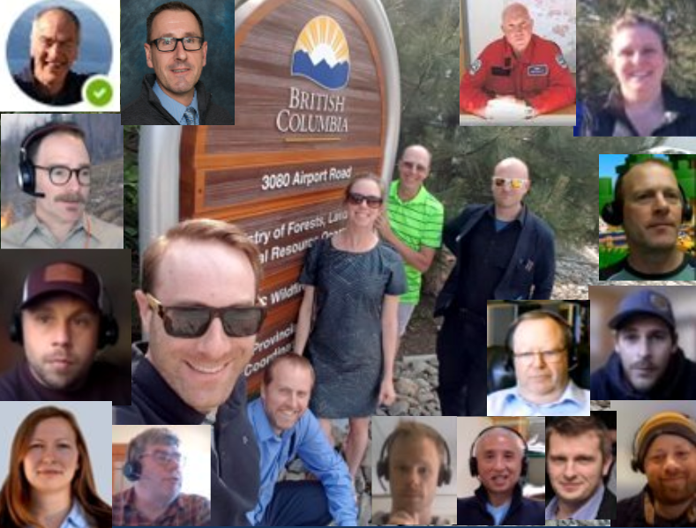
BCWS Predictive Services Unit
Report to Deputy Director, Wildfire Operations
Meteorologists
Fire Behavior Analysts
Agile Dev Team: software engineers, UX/UI, scrum-master
Data Science team: enhancing operational use of RS platforms
promoting continuously-updating geo-intelligence
Mandate:
Daily and increasingly-proactive situational awareness to support Prevention, Preparedness, Response, Recovery

Slide 5
Data Science
Math, stats, computing science, business acumen, domain expertise
Transparent reproducible methods. Data-driven decisioning..
Partnerships & capacity building.. DS CoP and RS CoP!
Non-proprietary languages, scaleable systems..
Work in open w cross gov teams
Collaboration
Speed of trust
Key support for GBA+ in providing data-driven sights into differential impacts (and determinants) of public policy
DS is one cheerleader for these things among many others..
Personal spin: emphasis on approaches that generalise across applications

Slide 6
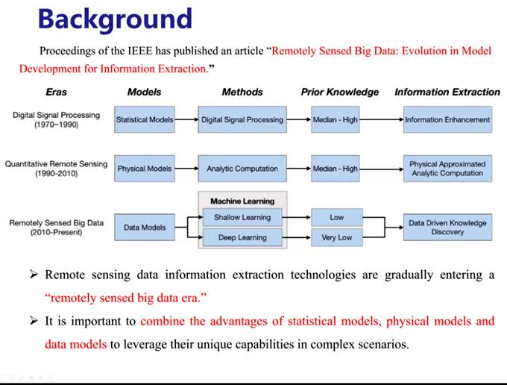
Me
NFI UVic AM
I like working on problems that are almost intractable!
(BC Gov 2018- ) concurrent projects:… Data Integration
Data Innovation Program (DIP)
population scale --> longditudinal research on services and outcomes
--> best outcomes for Citizens
Large multi-TB tabular data
Fuel Type Layer project (FTL)
landscape scale data integration --> outcomes
for ecosystem / landscape risks...!
"big" Remote Sensing data
…. real world:
Need statistical, physical and data models!
How to do this with tabular data and why does it matter?
First aid officer
Sep 21, 2020 Xing Mengdao (Zoom IEEE GRSS presentation

Slide 7
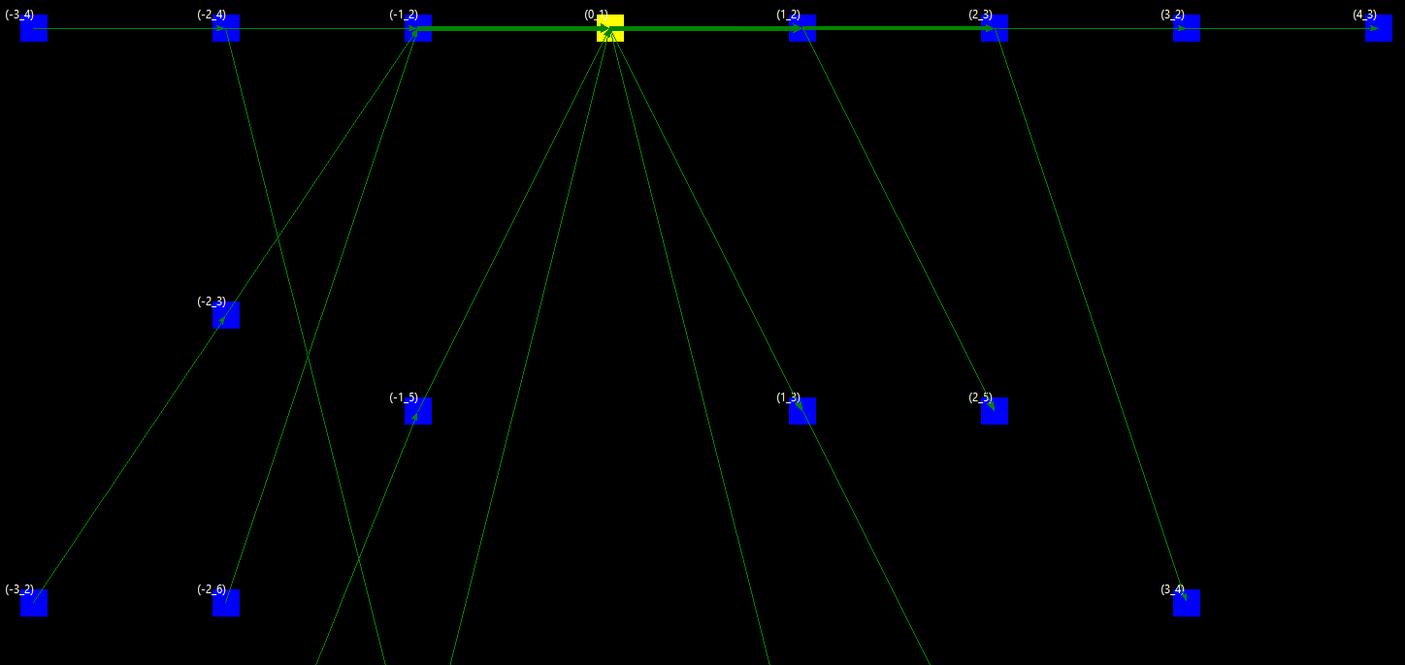
Hourglass / Sablier
une histoire a du temps et de l'espace
Answer: a story needs time and space!
Not a black box
An investigative tool
Makes the invisibile, visible
Hetero tabular data from complex arrays of services
Highlights repeating patterns of
outcomes and determinants, to
provide critical info:
where to target prevention
or intervention
..Has a built-in complexity knob
That serves as an approach to
The data anonymization
Problem : )
Also has a built-in redaction button
Indeterminate diagnosis is resolved (condition redacted)
Wanted to approach Machine Learning's goals in a transparent, accessible, non-subjective, way leading to a visual output that translates into words (withoutsophisticated math or stats)

Slide 8
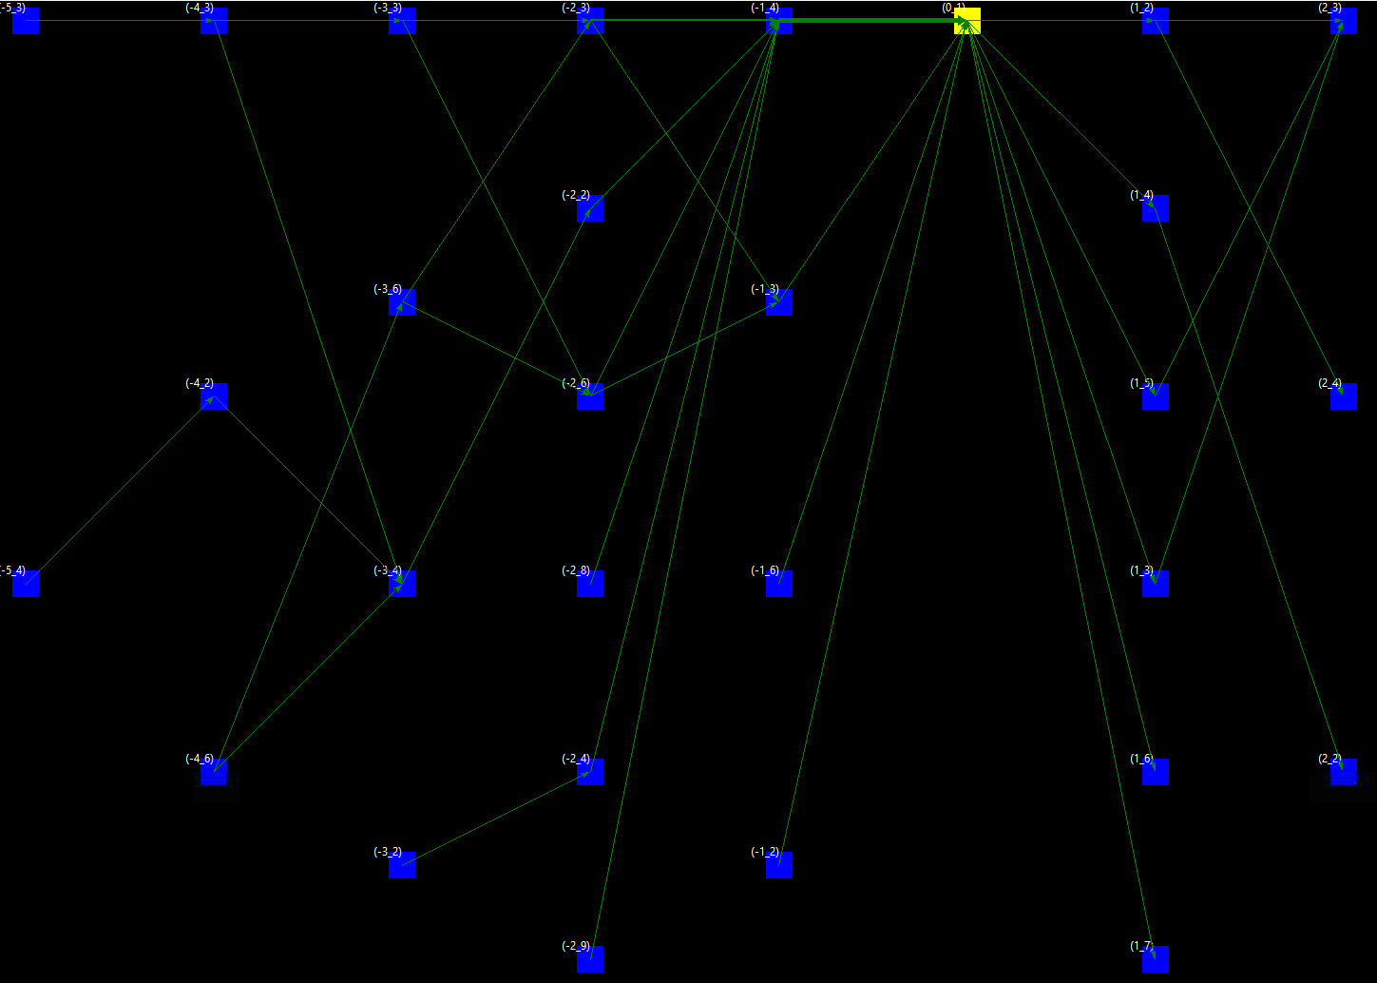
Effect of a disease
Past
Future
Differential risk profile
Exposure is not uniform
Time asymmetry:
More info available about situations leading up to the Disease, rather than away from it
Disease inserts disorder into the patient journey
The hazard / risk landscape associated with the Disease outcome, changes depending on which direction in time we are looking
What does it have to do with Ecosystem monitoring? "Easy"...
- 1) supposing we curate and discretize our remote sensing data appropriately, problem solved!
But not quite, still lots of work to do...
- 2) Also apparently the planet is sick and it needs help!
What about Space Mission planning for categorical inputs / outputs?

Slide 9
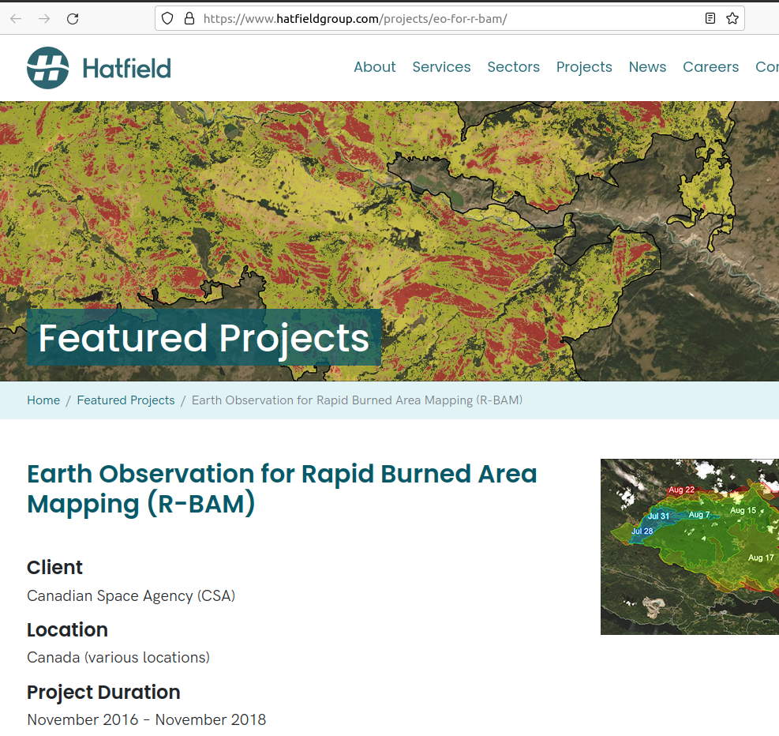
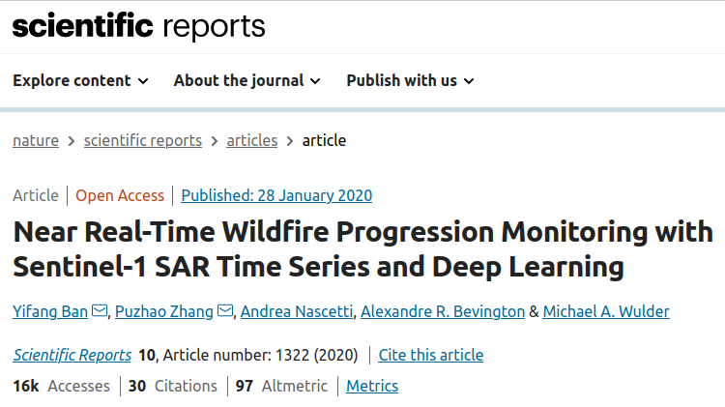
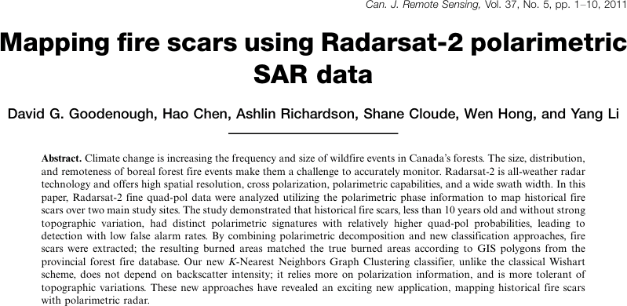
Can we map fire progression w CP-pol?
Probably
Claims to fame 1) working with CSA 2) mapping fires from space 3) making an unsupervised kNN variant

Slide 10
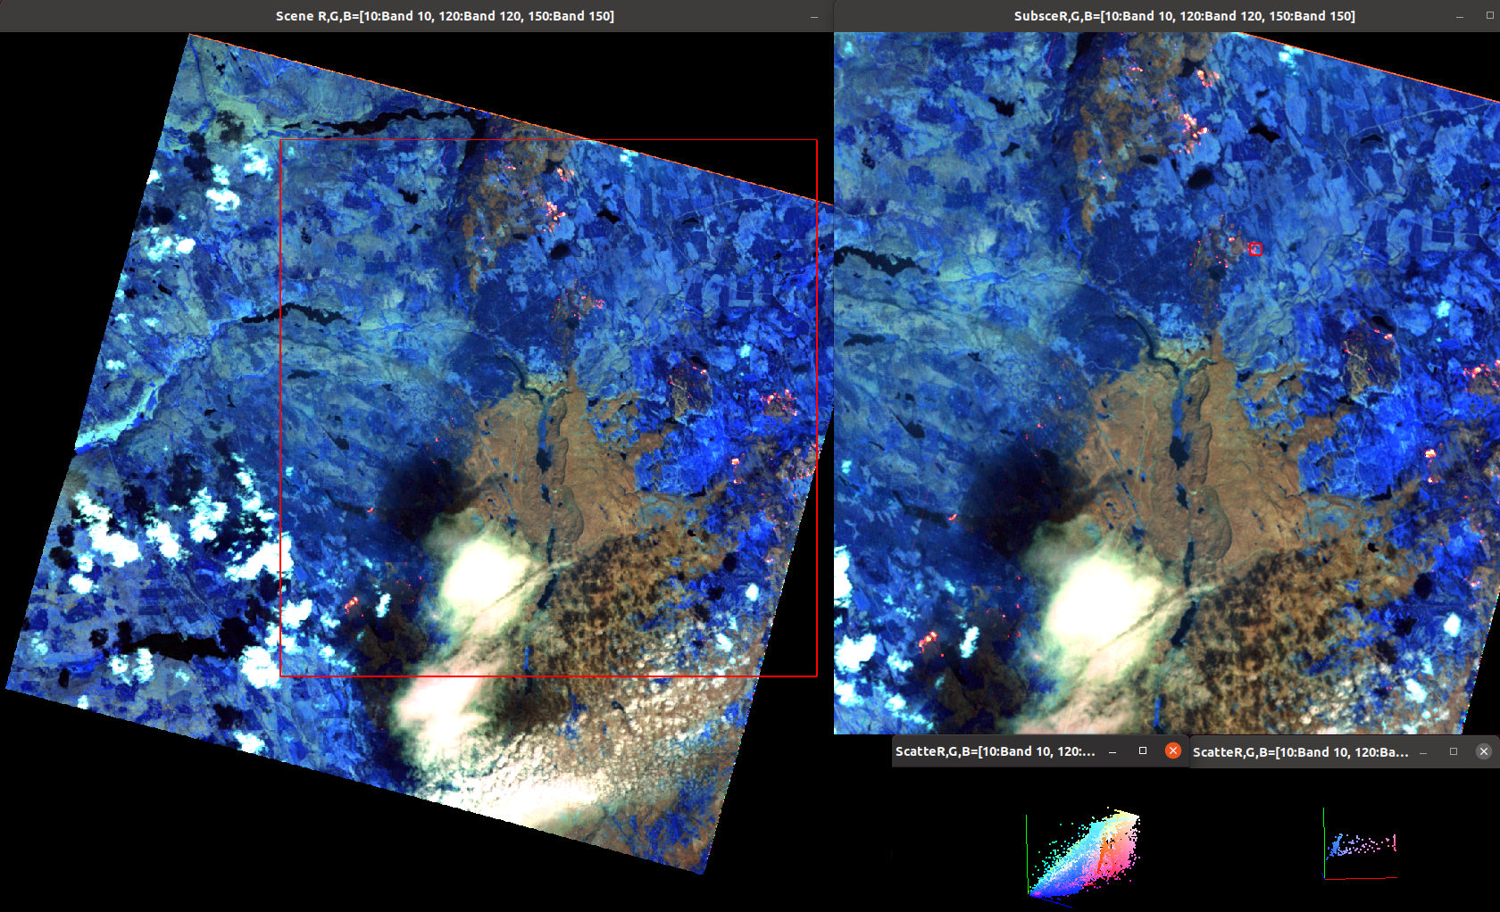
PRISMA © 2021 ASI

Slide 11
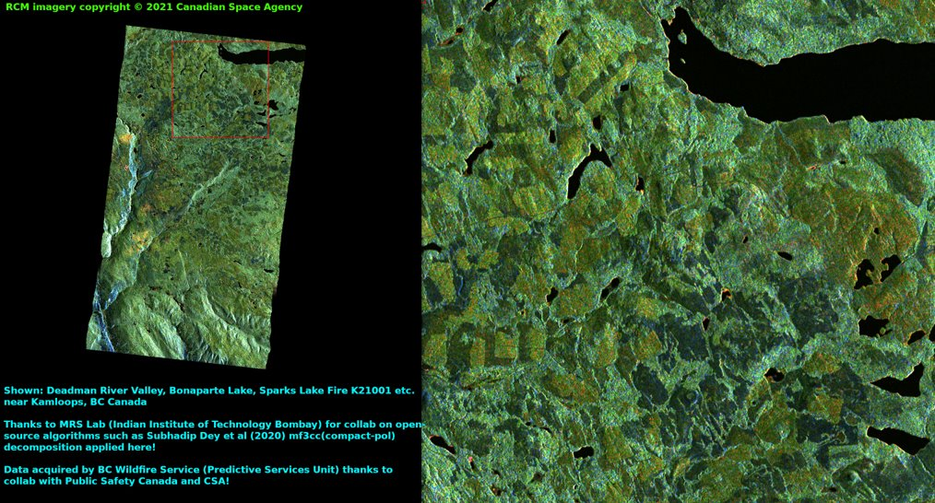
Compact pol modelling (thanks PSC / GOC and CSA)

Slide 12
Datasets
July | July | July | July | (*) = 5MCP18
08 | x | 16 | 20 | 5MCP7
x | x | x | x
10 | 14 | 18(*) | 22 | 5MCP19
x | 15 | 19 |  | 5MCP13
Sentinel2 (T09VUE)
2021: 0626, 0629, 0714, 0719, 0729, 0813, 0907
RCM
5MCP13/1/RCM1_OK1691981_PK1706567_1_5MCP13_20210719_141524_CH_CV_SLC.zip
5MCP13/1/RCM3_OK1691981_PK1702423_1_5MCP13_20210715_141546_CH_CV_SLC.zip
5MCP13/2/RCM3_OK1691981_PK1702423_2_5MCP13_20210715_141546_CH_CV_SLC.zip
5MCP13/2/RCM1_OK1691981_PK1706567_2_5MCP13_20210719_141524_CH_CV_SLC.zip
5MCP18/1/RCM2_OK1691998_PK1705054_1_5MCP18_20210718_015829_CH_CV_SLC.zip
5MCP18/2/RCM2_OK1691998_PK1705054_2_5MCP18_20210718_015829_CH_CV_SLC.zip
5MCP19/1/RCM2_OK1692000_PK1696175_1_5MCP19_20210710_140734_CH_CV_SLC.zip
5MCP19/1/RCM2_OK1692000_PK1710386_1_5MCP19_20210722_140735_CH_CV_SLC.zip
5MCP19/1/RCM3_OK1692000_PK1701412_1_5MCP19_20210714_140746_CH_CV_SLC.zip
5MCP19/2/RCM2_OK1692000_PK1710386_2_5MCP19_20210722_140735_CH_CV_SLC.zip
5MCP19/2/RCM2_OK1692000_PK1696175_2_5MCP19_20210710_140734_CH_CV_SLC.zip
5MCP19/2/RCM3_OK1692000_PK1701412_2_5MCP19_20210714_140746_CH_CV_SLC.zip
5MCP7/1/RCM1_OK1691994_PK1693935_1_5MCP7_20210708_142323_CH_CV_SLC.zip
5MCP7/1/RCM1_OK1691994_PK1707831_1_5MCP7_20210720_142324_CH_CV_SLC.zip
5MCP7/1/RCM3_OK1691994_PK1703442_1_5MCP7_20210716_142346_CH_CV_SLC.zip
5MCP7/2/RCM3_OK1691994_PK1703442_2_5MCP7_20210716_142346_CH_CV_SLC.zip
5MCP7/2/RCM1_OK1691994_PK1707831_2_5MCP7_20210720_142324_CH_CV_SLC.zip
5MCP7/2/RCM1_OK1691994_PK1693935_2_5MCP7_20210708_142323_CH_CV_SLC.zip
z

Slide 13
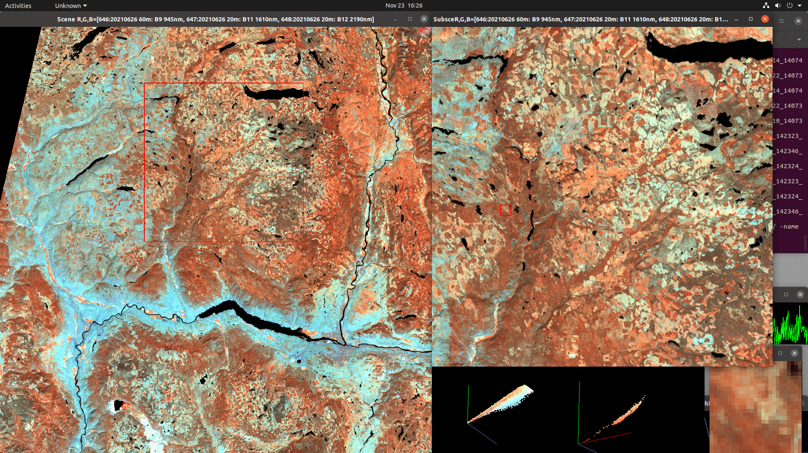
Datasets
Sentinel2 © ESA
z
Sentinel2 (T09VUE)​ 2021: 0626, 0629, 0714, 0719, 0729, 0813, 0907

Slide 14
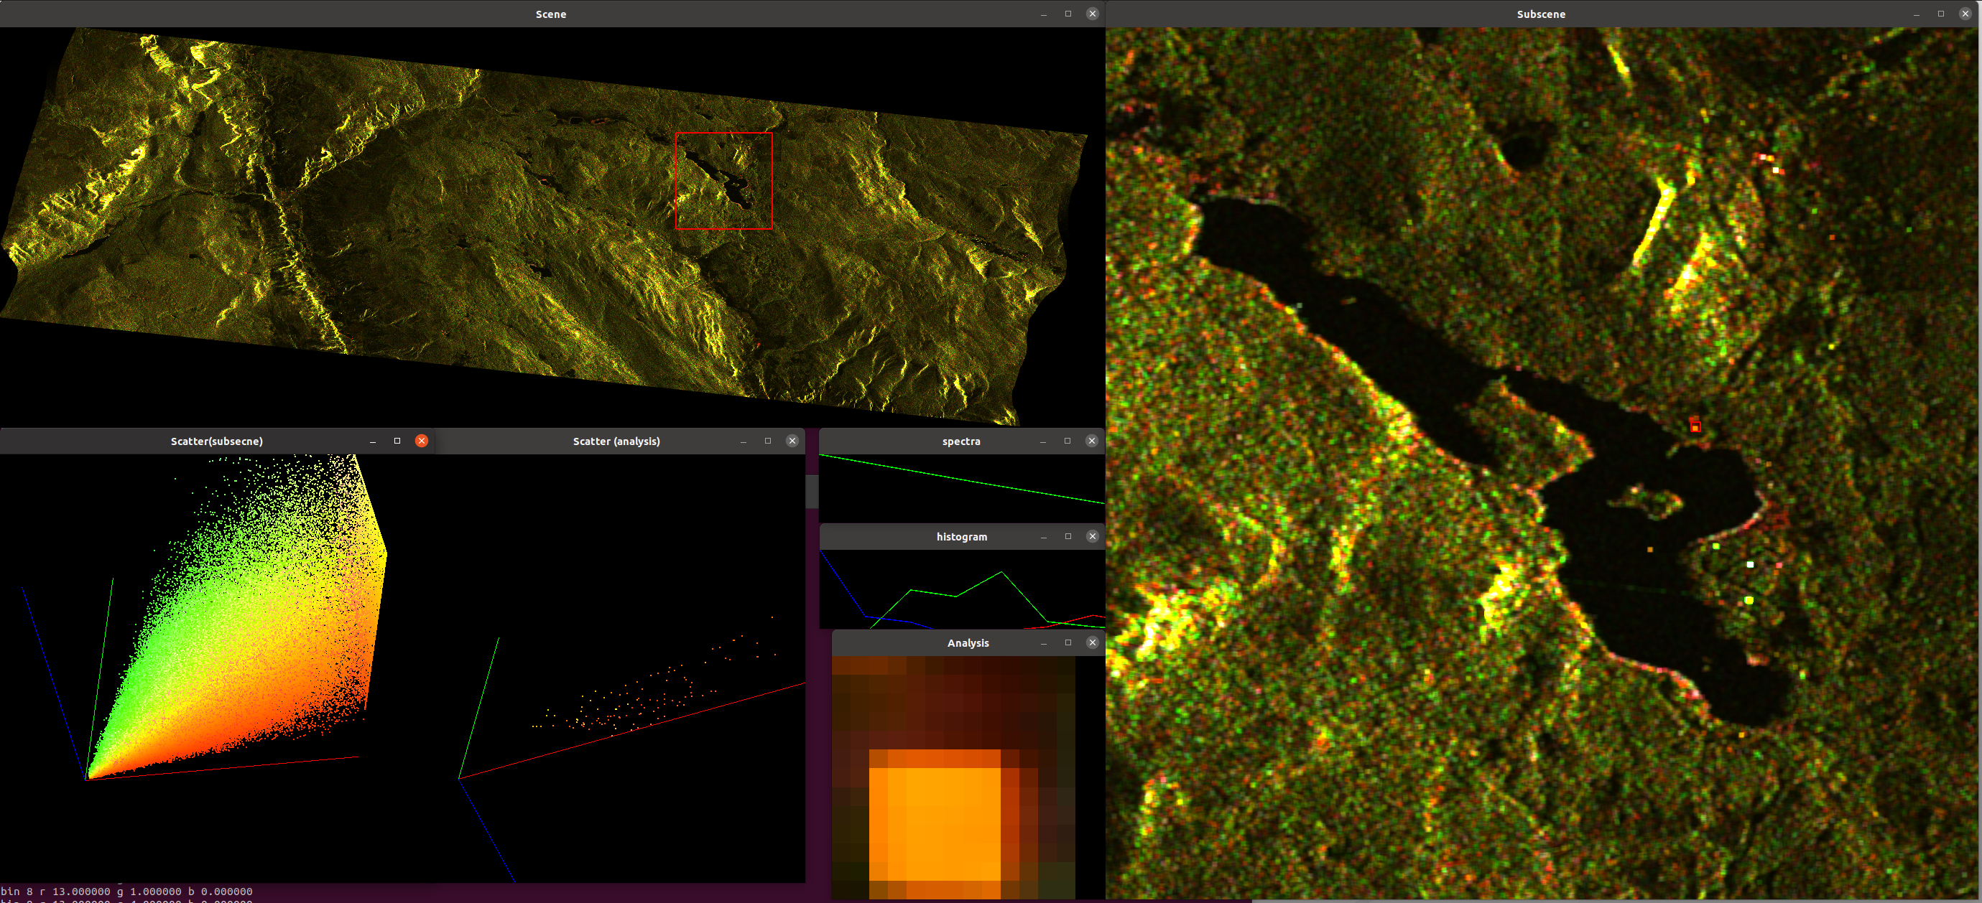
9 takes x 2 pieces...
z
RCM © Canadian Space Agency

Slide 15
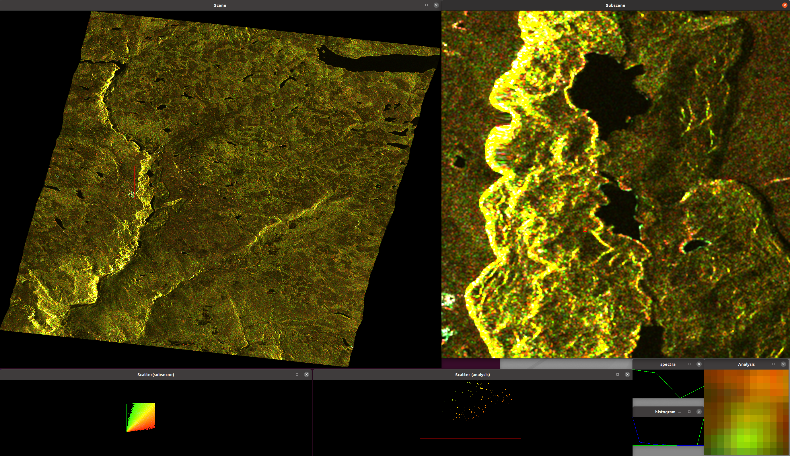
Datasets
RCM © Canadian Space Agency
z

Slide 16
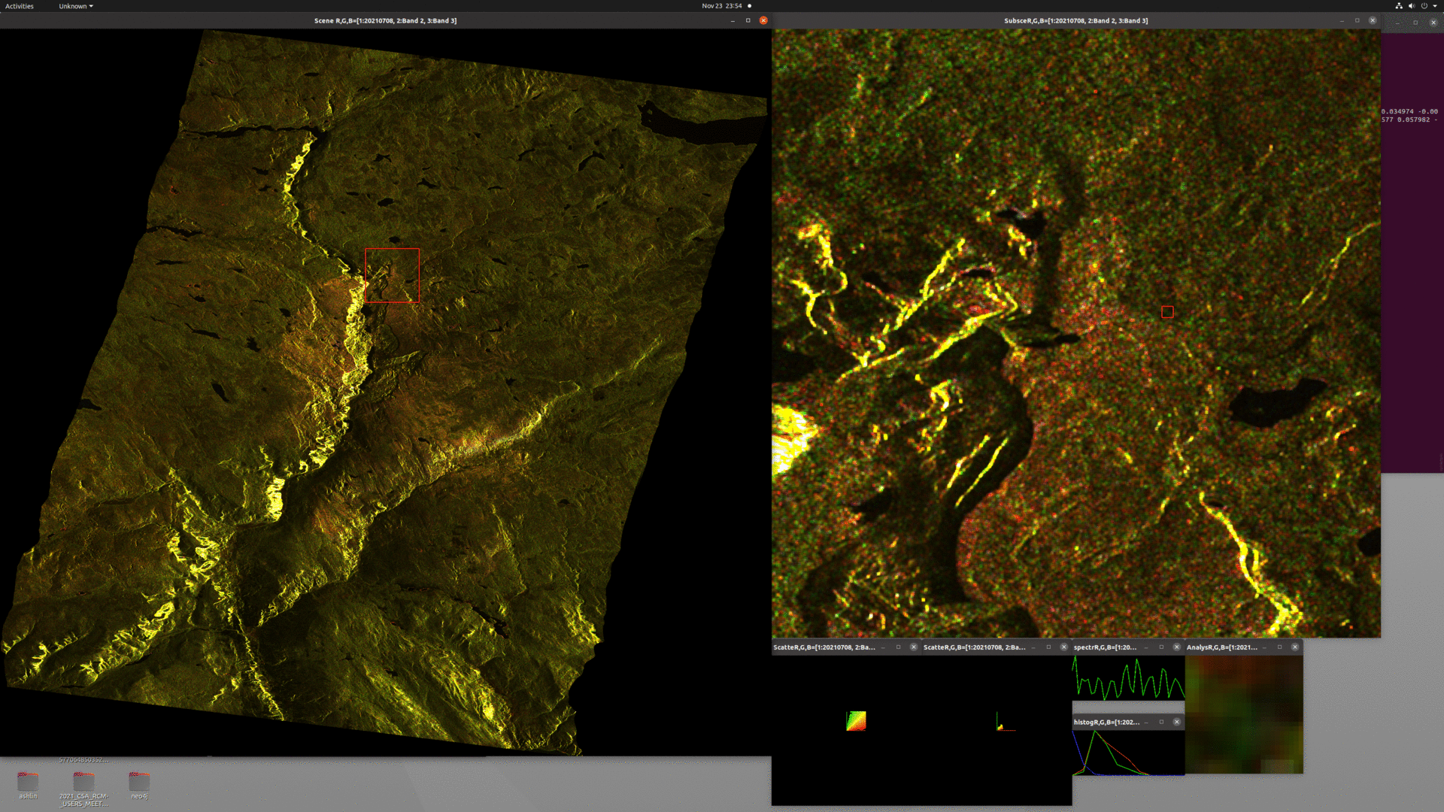
Datasets
RCM © Canadian Space Agency
(C11, C12, C12_real) After mosaicing / coregistering.. all sets
z

Slide 17
RCM steps
July | July | July | July | (*) = 5MCP18
08 | x | 16 | 20 | 5MCP7
x | x | x | x
10 | 14 | 18(*) | 22 | 5MCP19
x | 15 | 19 |  | 5MCP13
Range / Doppler Terrain Correction,
Box Filter
mf3cc decomposition (double, volume, surface, angle)
Mosaic the 2 pieces together for each of the 9 dates..
Group by beam mode..
Calculate time diffs
(4 modes) … 5 differences total
3x 5MCP7 = 2x differences
1x 5MCP18 = 0x differences
3x 5MCP19 = 2x differences
2x 5MCP13 = 1x difference
Daily x14 same mode--> 13 differences..
Daily x14 in 4 modes: -->9 differences..
[1] Dey, S., Bhattacharya, A., Ratha, D., Mandal, D. and Frery, A.C., 2020. Target characterization and scattering power decomposition for full and compact polarimetric SAR data. IEEE Transactions on Geoscience and Remote Sensing, 59(5), pp.3981-3998.​ ​ [2]. Dey, S., Bhattacharya, A., Frery, A.C., López-Martínez, C. and Rao, Y.S., 2021. A Model-Free Four Component Scattering Power Decomposition for Polarimetric SAR Data. IEEE Journal of Selected Topics in Applied Earth Observations and Remote Sensing, 14, pp.3887-3902.​ ​ [3]. Dey, S., Bhogapurapu, N., Homayouni, S., Bhattacharya, A. and McNairn, H., 2021. Unsupervised Classification of Crop Growth Stages with Scattering Parameters from Dual-Pol Sentinel-1 SAR Data. Remote Sensing, 13(21), p.4412.​
z

Slide 18
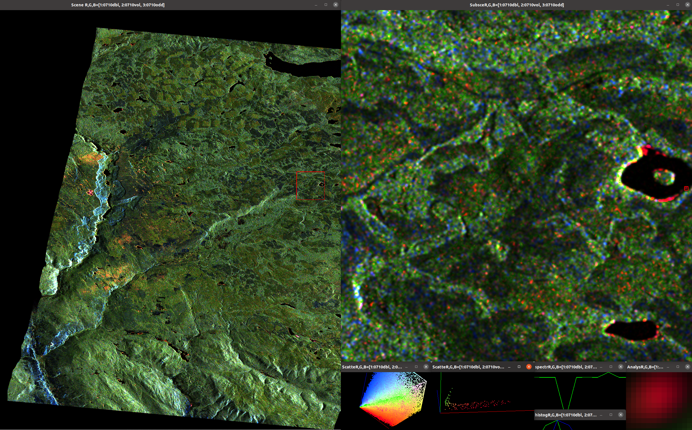
Cp-pol decom mf3cc
RCM © Canadian Space Agency

Slide 19
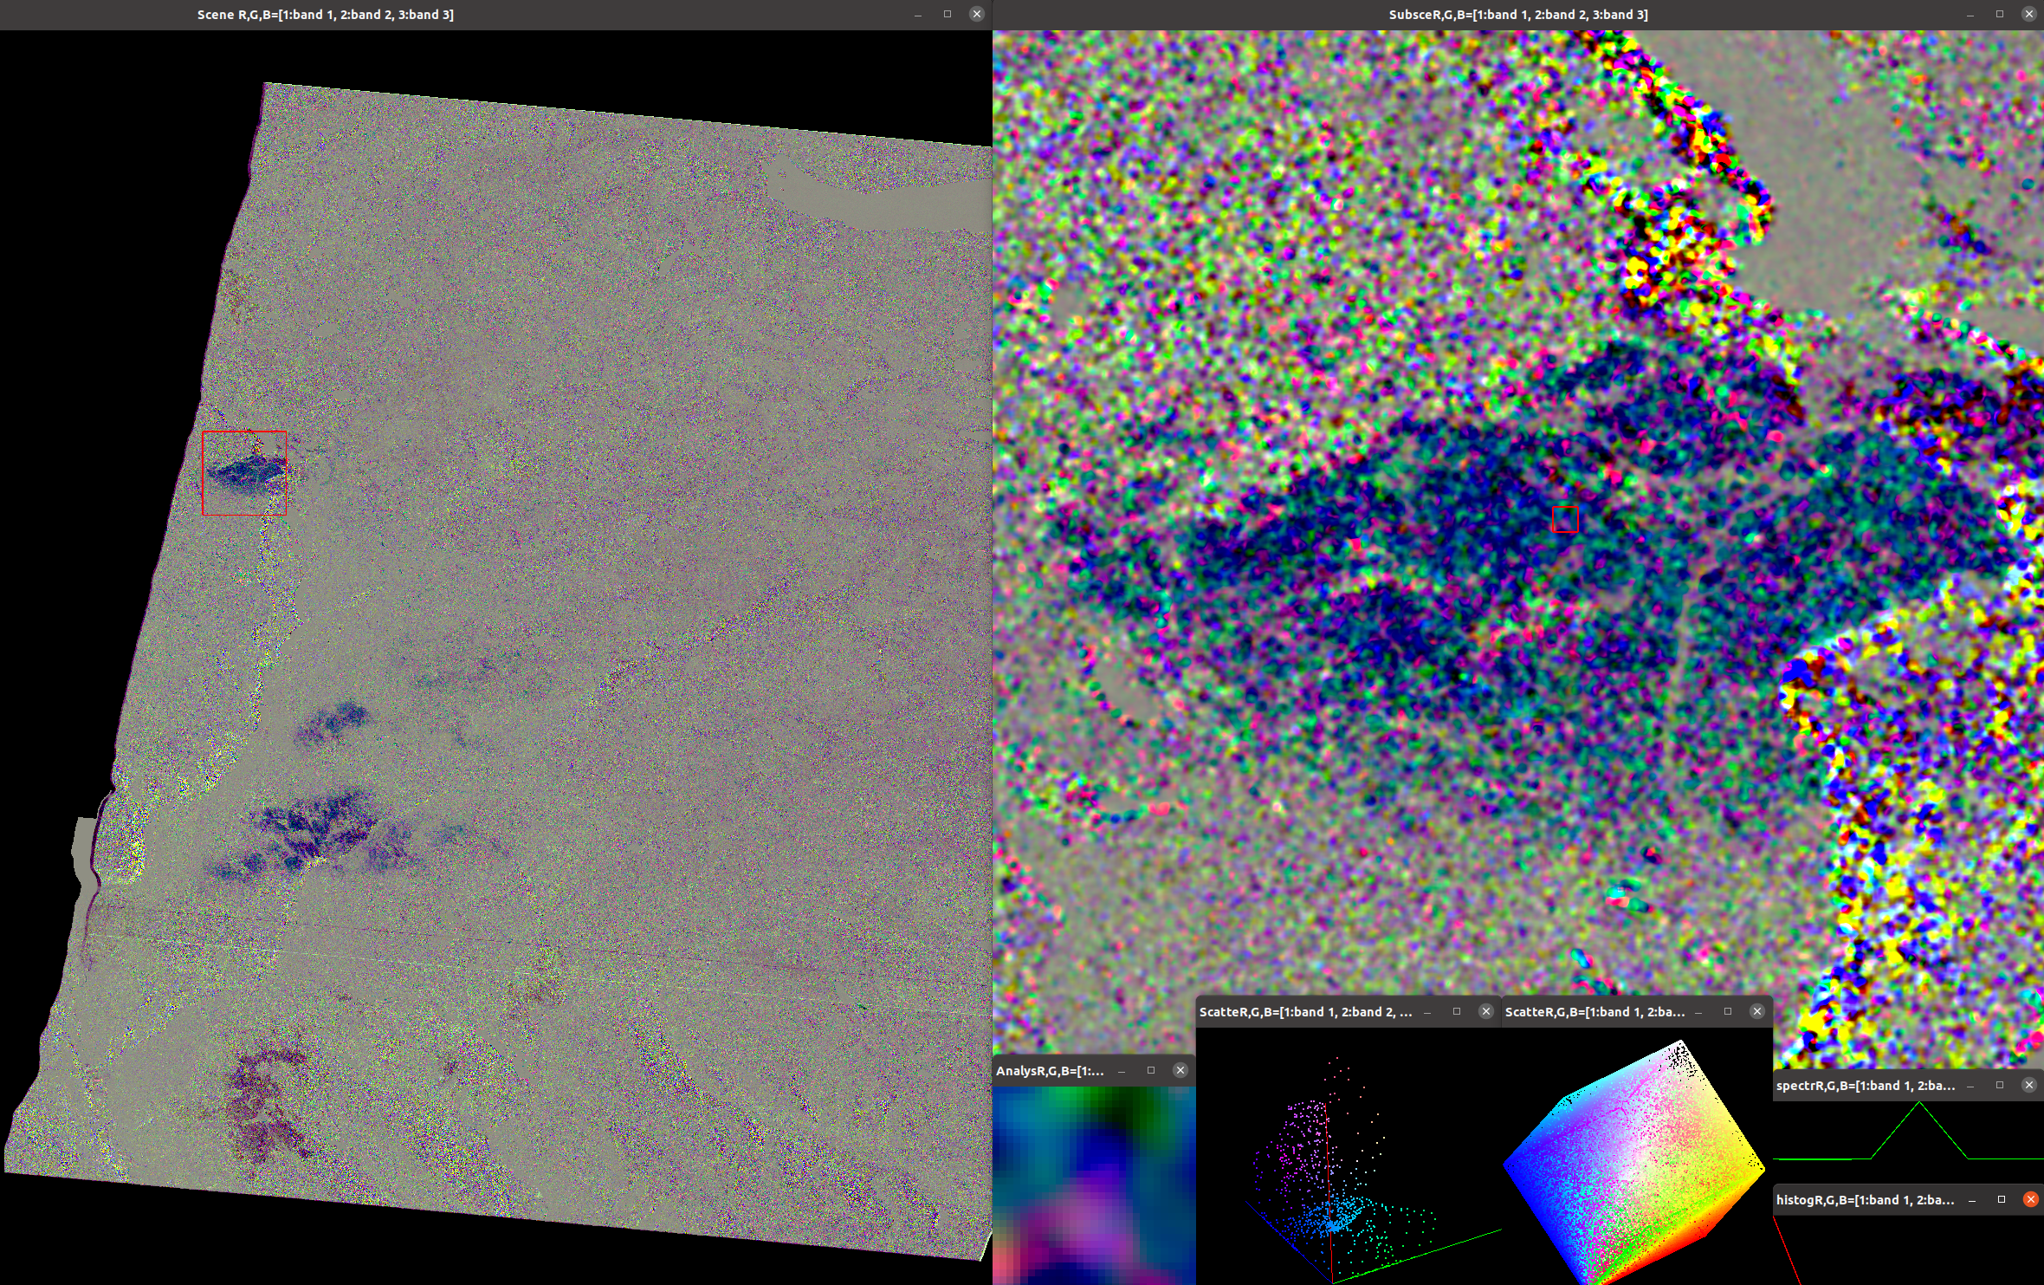
Datasets
5MCP19: 0710 - 0714
RCM © Canadian Space Agency
z

Slide 20
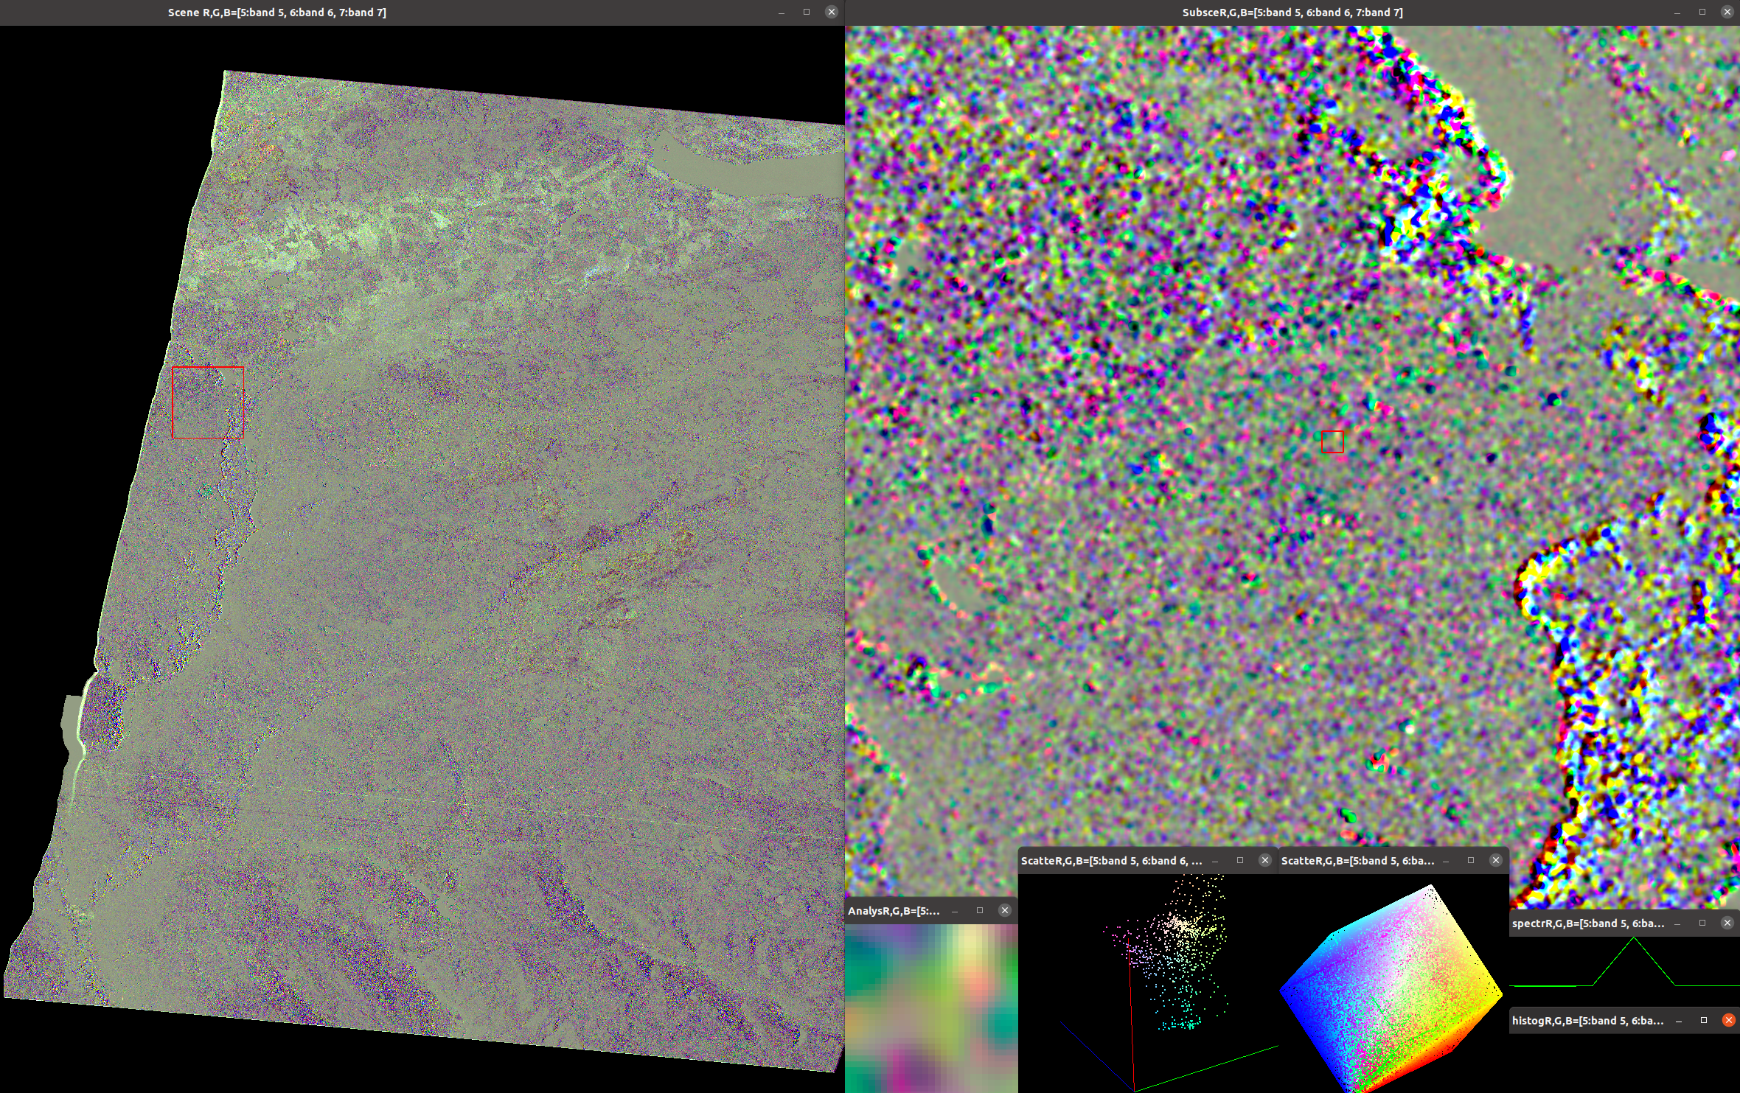
Datasets
5MCP19: 0722-0714
?5MC
RCM © Canadian Space Agency
z

Slide 21
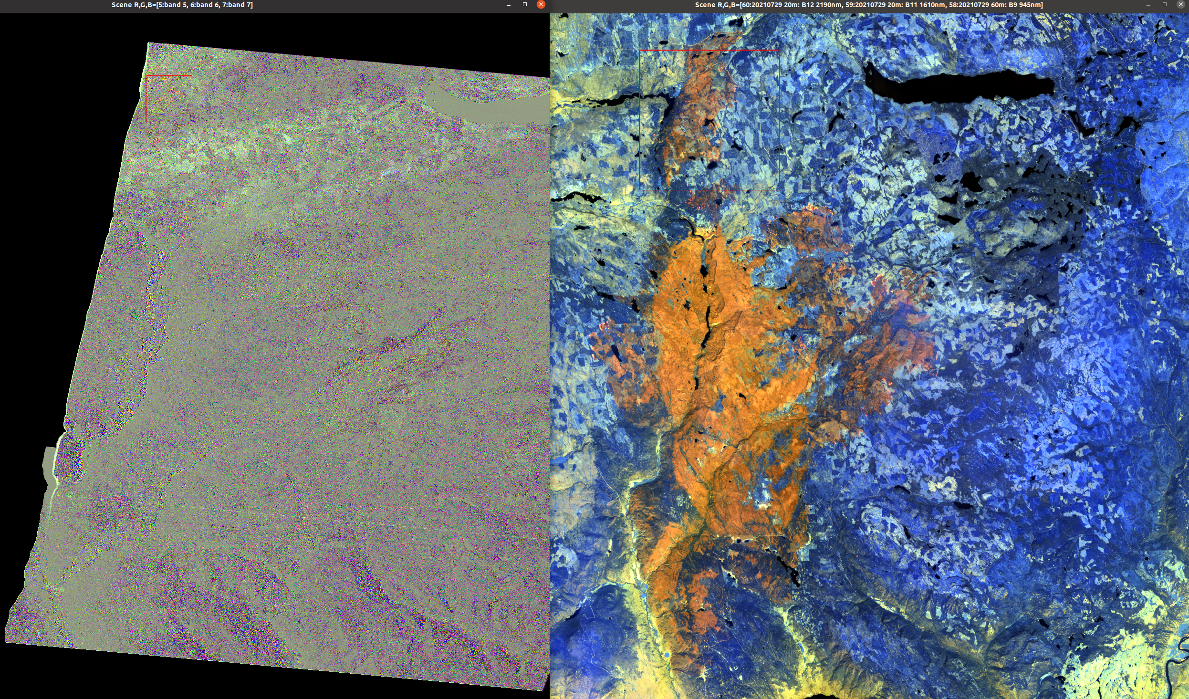
5MCP19: 0722-0714
RCM © Canadian Space Agency

Slide 22






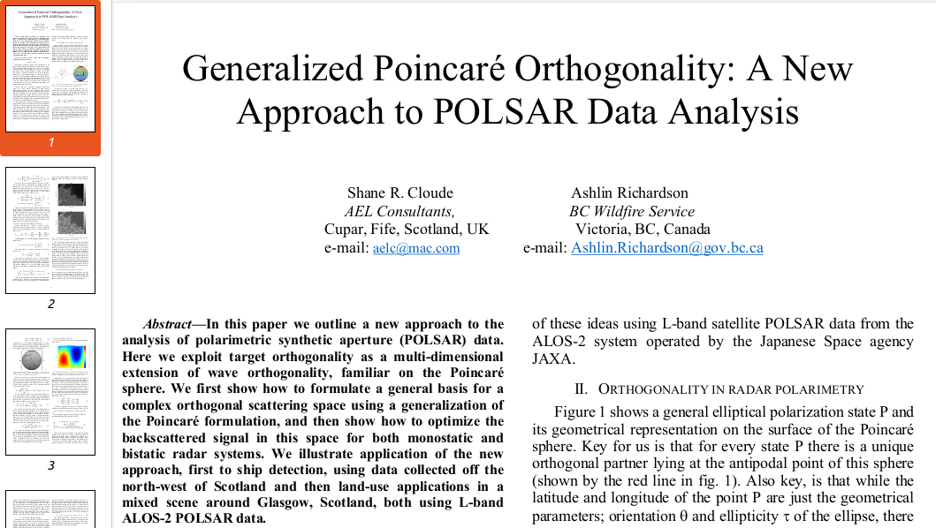
Thanks
CSA for the collaboration and Extraordinary data!
Opportunity to improve consistency or quality of collections
For collab w CSA, CFS, NRCAN and partners on RCM and enhancing
use of RS tech. Thanks Dr. Ake Rosenqvist for consultation
ESA (Esp. Dr. Pottier) & NASA for RS training in 2021
Dr. Cloude & Dr. Dey for mini collabs in open source!
EGC / PSC for tasking. Thanks to Capella for a sample tasking
Thanks A Beaudoin for S1 burn maps. Want to work with CFS on fires/fuel!
Next steps: Operational-integration engineering.
Forest fuels study w Brad Martin, Senior Fire Protection Officer, present to BVRC Dec 8
Pursue PolSAR, Multi & Hyperspec, LiDAR for fire
and inter-related hazards, and ecosystem support
Work with TRU on fire science
Collaborate with other application areas
Hope to work w JAXA, CFS and IITB on ALOS integration
Aiming to exploit PolInSAR, quad-pol and dense series
Working w BC gov RS and DS CoP to build capacity

